Slide 1
Tech for Teachers
Tech Day 2018

Slide 3
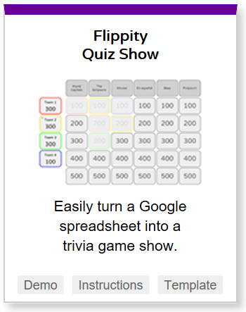
Games for Review
Kahoot Jumble
Create questions where the answers need to be put in order
Flippity
Flashcards
Quiz show
Name picker
Word search
Bingo
Hangman
Memory Game

Slide 4
Games for Review
Dustbin
Math practice games
Grades K-8
Algebra I and II, Geometry and Precalculus
Jeopardy Labs Online

Slide 5
Assessment
Socrative
Assessment tool
Online quizzes and exit tickets
Quiz Revolution
Multiple choice quizzes

Slide 6
Presentation Tools
Sutori
examples
https://www.sutori.com/story/chernobyl-e8a0

Slide 7
Classroom Tools
Wheel Decide
Wheel example
PhotoScan
Digitizes photos
Detects edges, brings multiple images together
GoNoodle
Get students moving when they need a break
Noisli
Background sound to improve focus and productivity

Slide 8
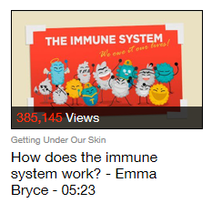
Teaching and Lessons
Google Cultural Institute
Primary source documents and archival images
TED ED
Extension of TED talks
Takes complicated ideas and makes animated shorts
Lessons that go with videos
Print Friendly
Removes ads from web pages
Keeps students from being distracted

Slide 9
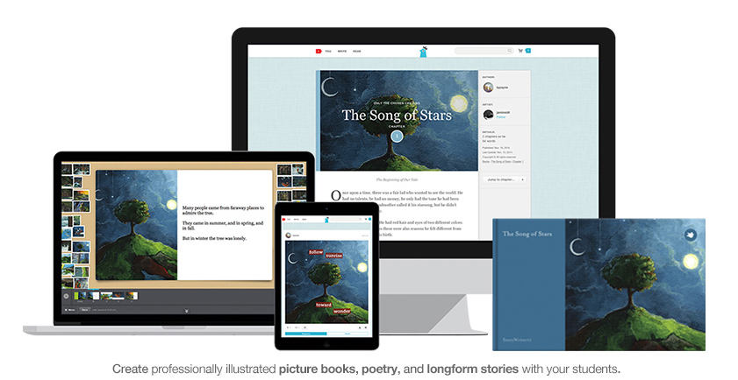
Storytelling Tools
Inklewriter
Interactive stories
Writer Igniter
Shuffle ideas
Character
Situation
Prop
Setting
Storybird
Create professionally illustrated books
Book Creator

Slide 10
Aurasma (now called HP Reveal)
App
Turns everyday objects into interactive learning stations
https://www.youtube.com/watch?v=uHIxYpBW7sc
Downside
Students will have to use their phones

Slide 11
Tilt Brush—Art App
Virtual Reality Painting

Slide 12
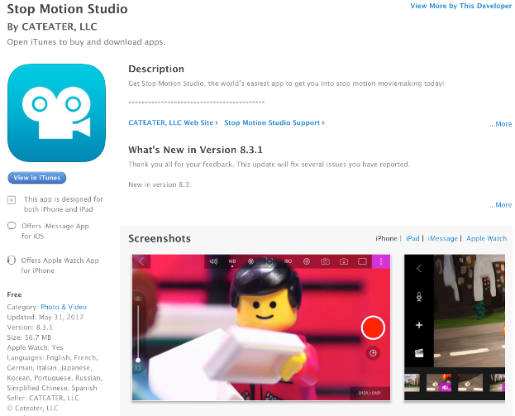
Stop Motion Studio
Stop motion moviemaking
For Apple devices

Slide 13
zSpace
Virtual Reality Learning for STEM

Slide 14
Analyze My Writing
Analyzes for
Readablity
Lexile
Passive voice
Common words and phrases
Sentence lengths

Slide 15
Flipgrid
Social learning through video posts

Slide 16
Spreeder
Speed reading web site
Helps improve reading rate

Slide 17
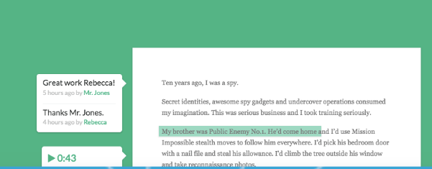
Kaizena
Personal feedback on student work
Voice message
Text
Track a skill
Attach a lesson

Slide 18
Ideas Taken from EWITC Conference
Amy Arbogash
Kara Bunkleman

